Slide 1

Cross-modal Ambiguity Learning for Multimodal Fake News Detection
WWW’22

Slide 2
Background
While people enjoy the convenience of online social media, the lack of systematic efforts to verify the credibility of online posts has led to the wide and fast spread of fake news across social platforms.
Online social content, such as microblog, has quickly evolved from text only to multimodality, often containing both text and images.
Cross-modal content analysis can offer complementary benefits to assist with fake news detection

Slide 3

Challenges
However, the prior works have not explicitly considered the inherent ambiguity across different content modalities, and thus lead to inferior performance.
The text and image present strong cross-modal ambiguity
e.g., the fake news example (left figure) tells a fictional death story but includes a smiling person’s image
→ Need multimodal feature fusion
In contrast, the unimodalities are semantically consistent
e.g., the real news example (right figure) expresses sad emotion with a blue image included.
→ Unnecessary cross-modal fusion features
Figure 1: Illustrations of cross-modal ambiguity.

Slide 4
Key Idea
The multimodal fake news detection methods should be aware of the ambiguity between different modalities and adaptively aggregate discriminative cross-modal features with unimodal features to perform better multimodal classification.

Slide 5
Introduction
This paper proposes CAFE — an ambiguity-aware multimodal fake news detection method, using the distributional divergence between different unimodal features to quantify their ambiguity:
A cross-modal alignment module, which can transform the heterogeneous unimodal features into a shared semantic space.
A cross-modal ambiguity learning module, which can estimate the ambiguity between different modalities.
A cross-modal fusion module, which can capture the cross-modal correlations by learning the semantic interactions.

Slide 6
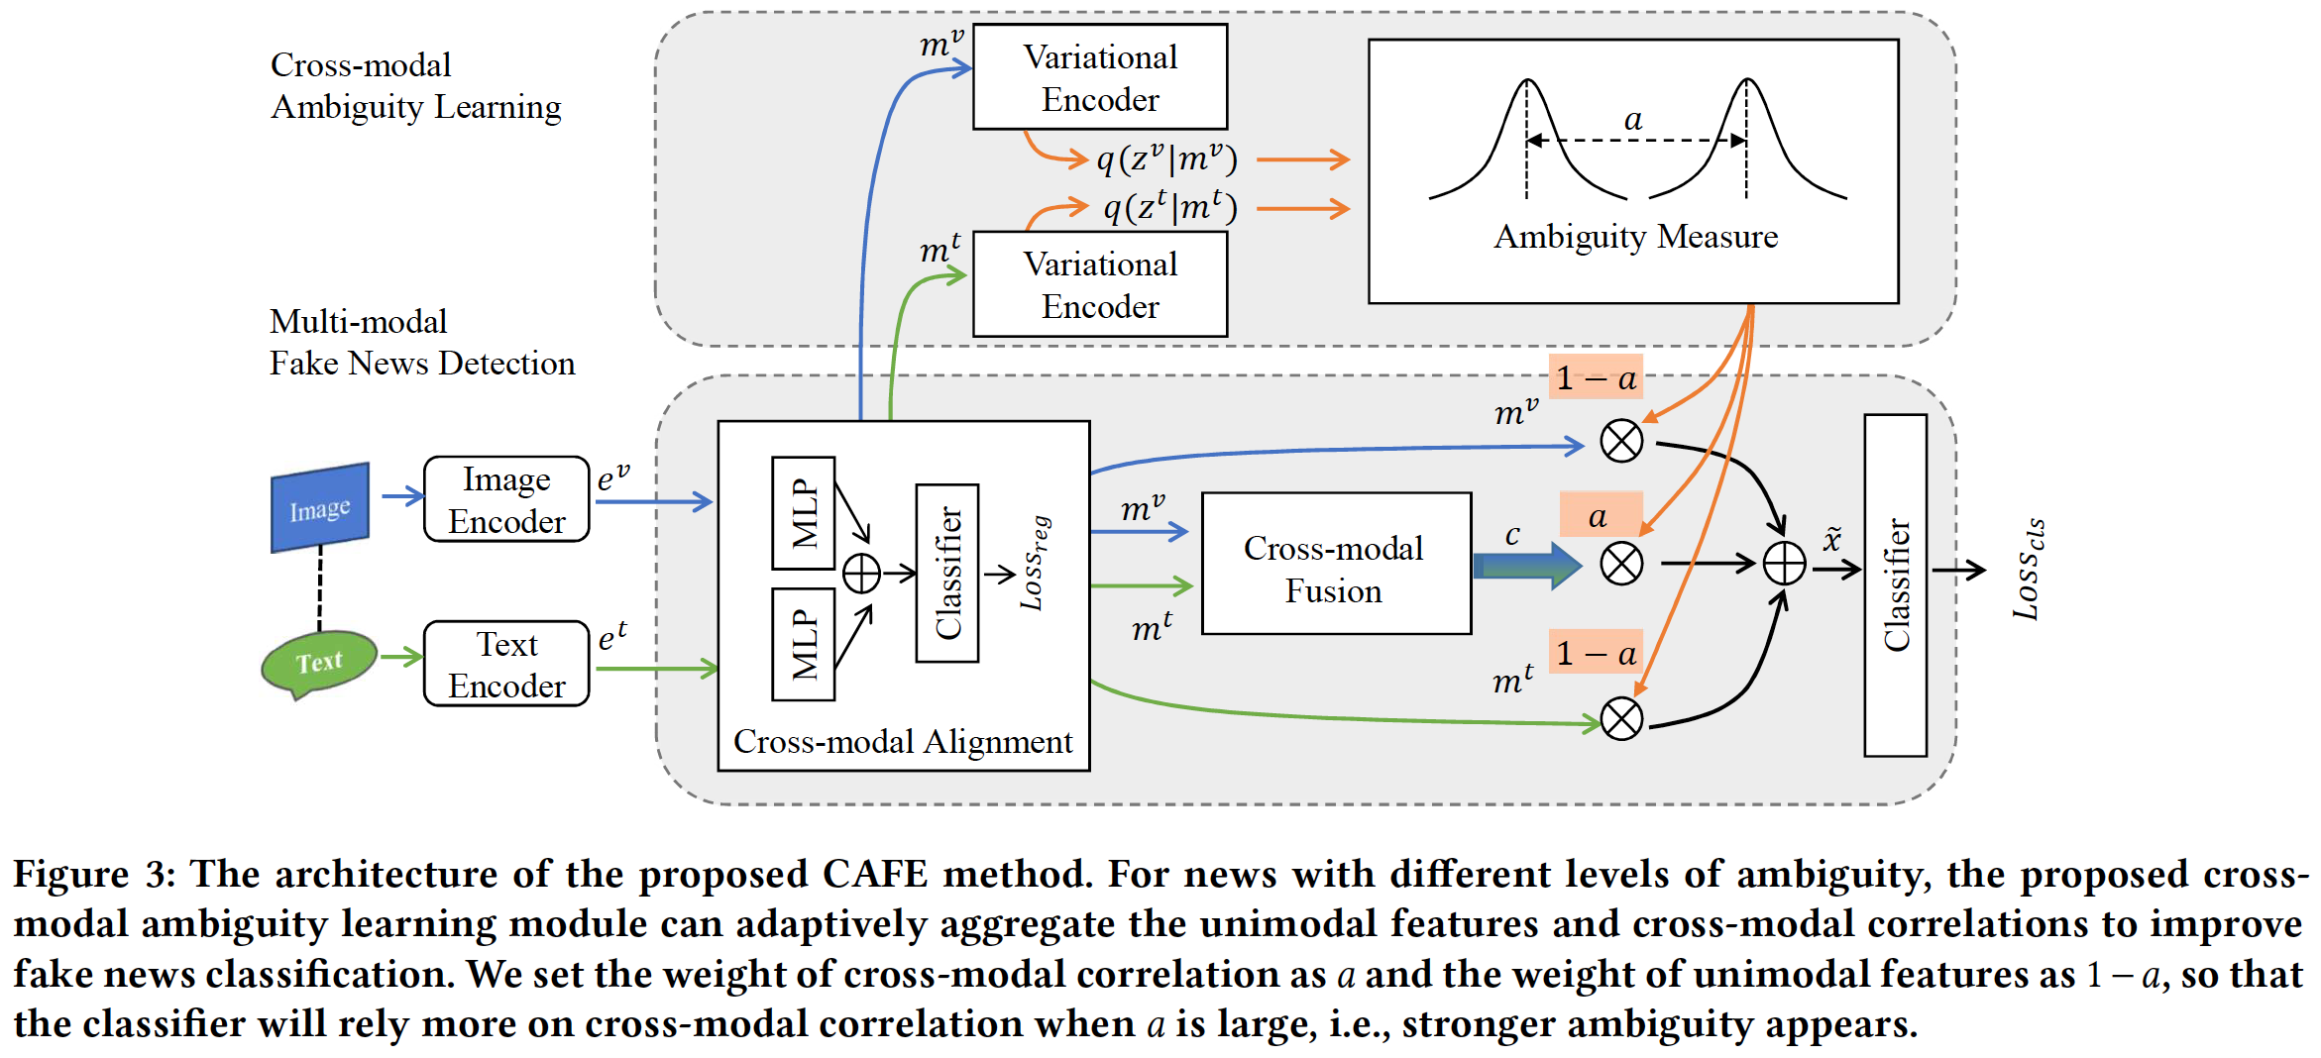
Overview

Slide 7
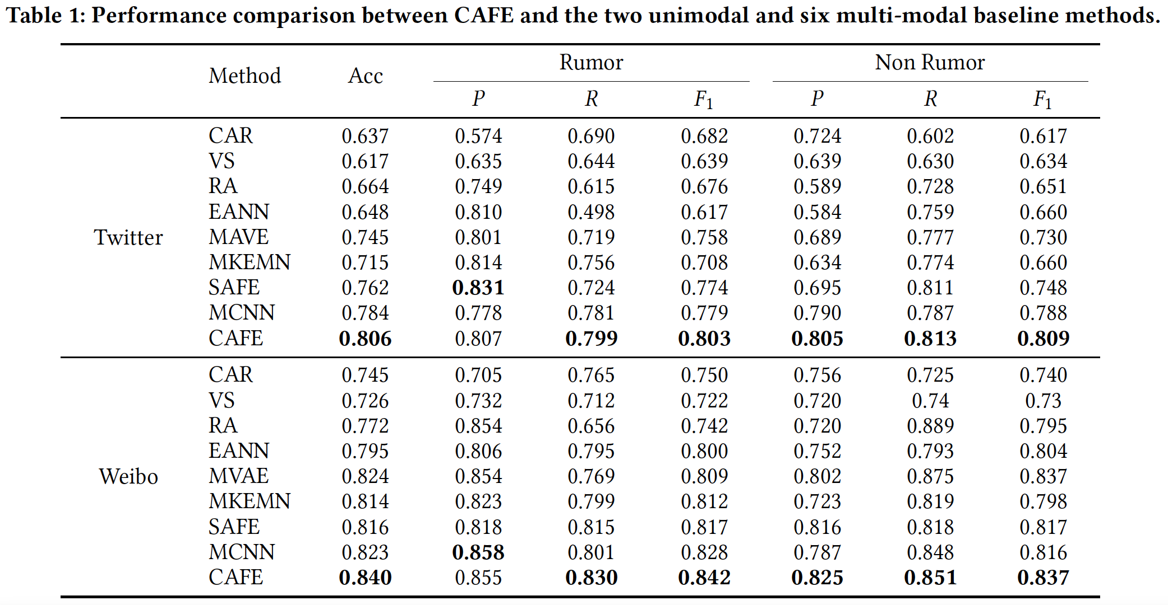
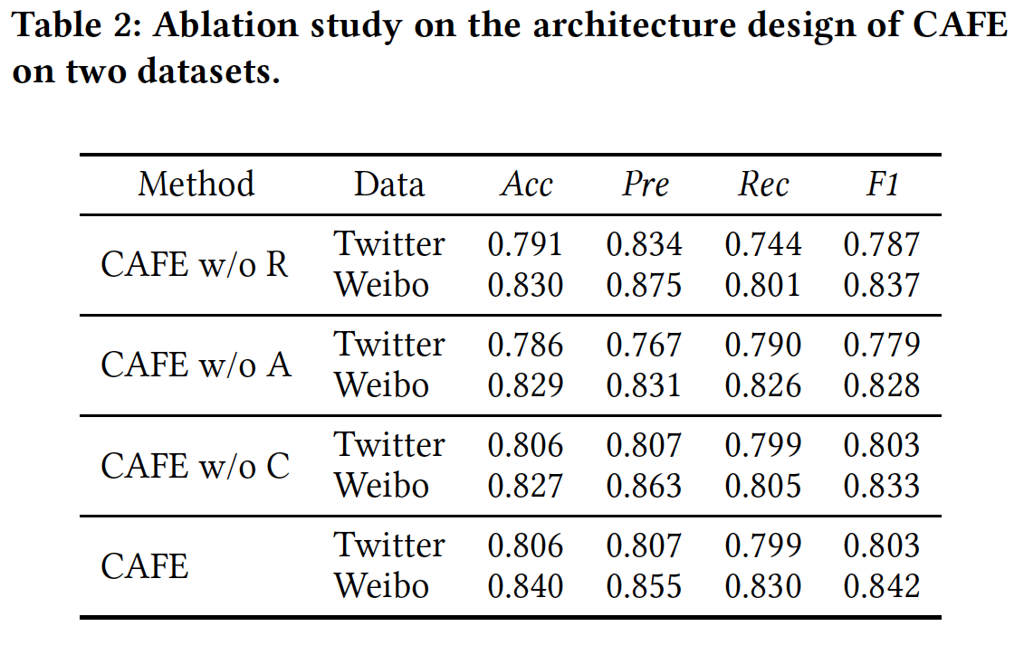
Experiment Results -- Overall Performance
* In table 1, P and R are for precision and recall respectively; in table 2, R denotes the alignment module, A denotes the ambiguity learning
Module, and C denotes the fusion module.

Slide 8
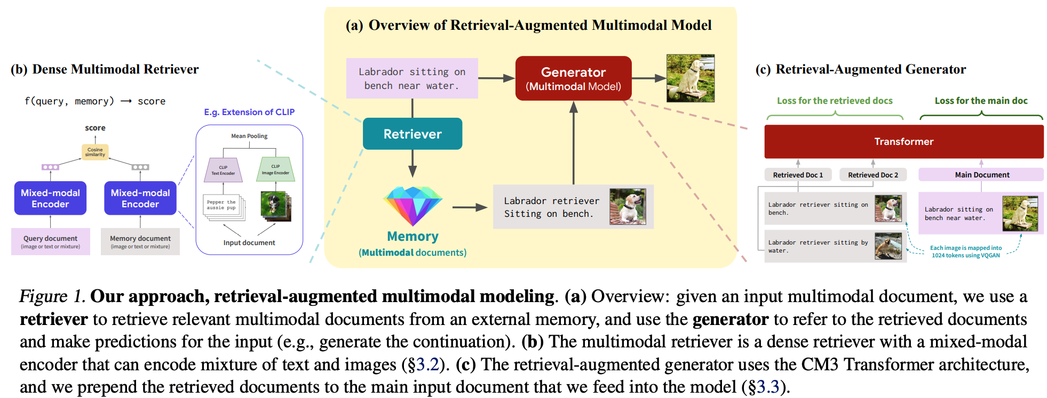
Associations about multimodal RAG (Retrieval Augmented Generation)
* 2023, Retrieval-Augmented Multimodal Language Modeling, ICML

Slide 9
Associations about multimodal RAG (Retrieval Augmented Generation)
Specialized for Fake News Detection, CAFE achieved balanced feature utilization by the ambiguity learning. Compared with the RAG, nevertheless, it still has the following drawbacks:
Flexibility and Scalability: RAG‘s retrieval-augmented approach might offer more flexibility and scalability, as it can dynamically access a vast range of external data.
Handling of Ambiguity: While CAFE addresses cross-modal ambiguity, RAG's ability to integrate information from diverse sources might offer a more general handling of ambiguity in multimodal data.
Generalization: The generalizability of CAFE's approach to different types of multimodal datasets and scenarios could be limited compared to RAG, which is designed to adapt to various contexts.
Explanatory for final detections: Unlike CAFE, which merely classifies results, RAG pinpoints misinformation subsections and their reasons, enriching the final explanation.
* 2023, Retrieval-Augmented Multimodal Language Modeling, ICML

Slide 10
Q & A?

